Slide 1

ML Project
- House Price Prediction
Akhil Awari

Slide 2
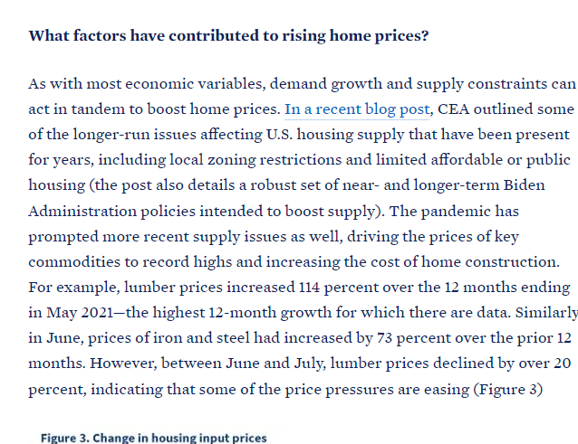
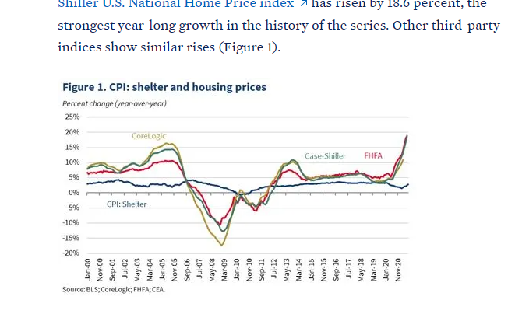

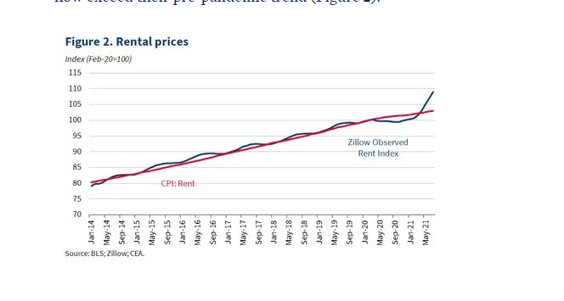

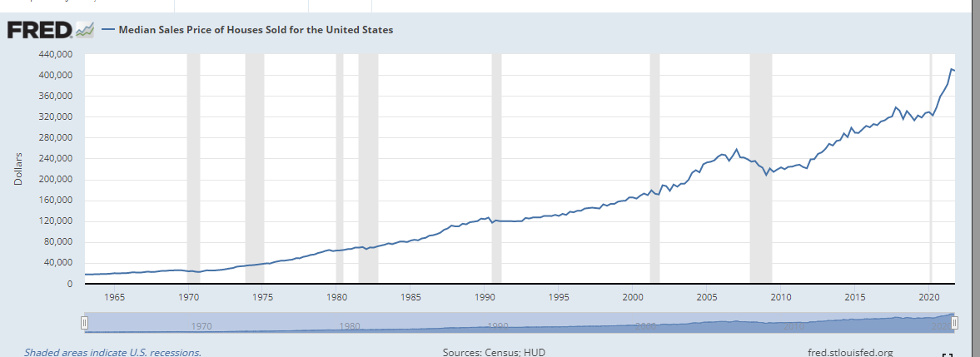
REASONS TO CHOOSE THIS STATEMENT…

Slide 3
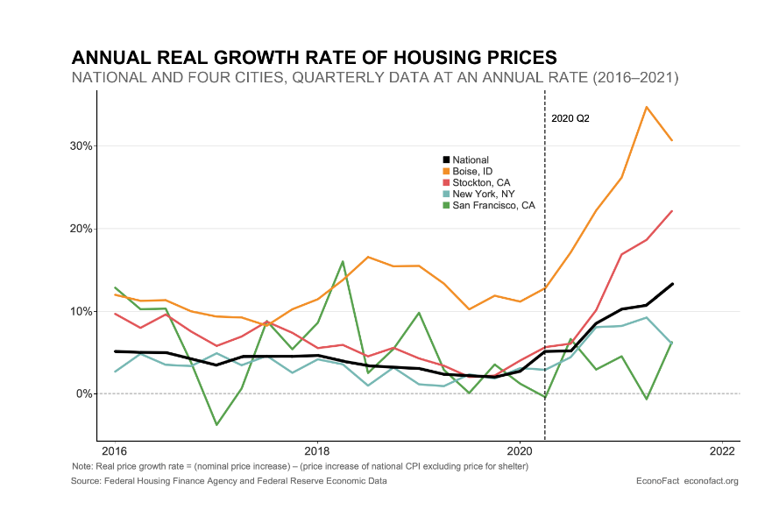
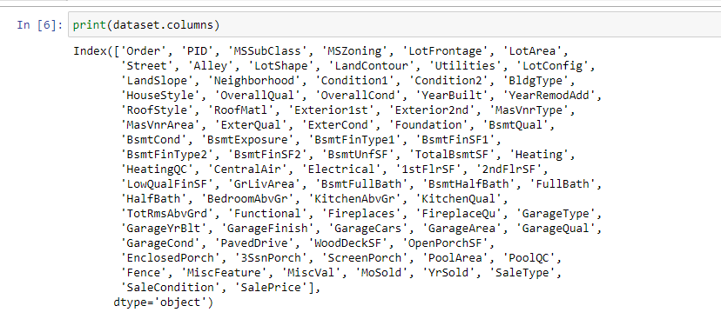
PROJECT OVERVIEW
Problem Statement:
Predicting Sale Price for houses in the future, by using historical house sales data. Created four regression models and chose the best one!
Data Set Description:
The data has 20,510 observations and 82 fields
‘Sale Price’ is our dependent variable
Each observation is the purchase data of one House - It describes various features of the house, year built, area, quality, etc.
The data has 39 integer variables and 43 categorical variables
Data Source:

Slide 4


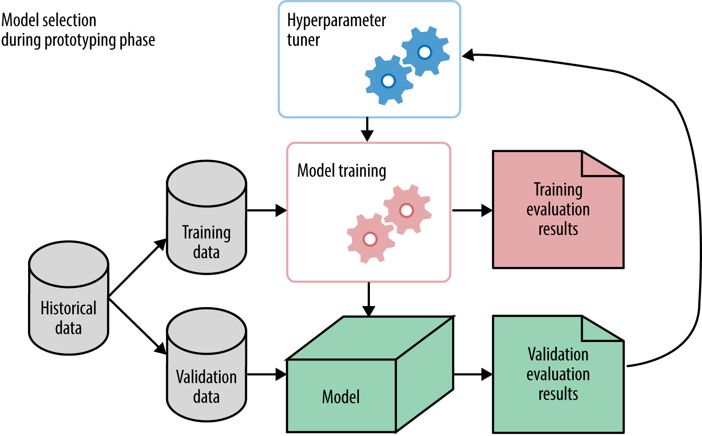
METHODOLOGY
Data Exploration
Feature Engineering
Model selection

Slide 5
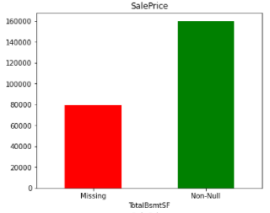
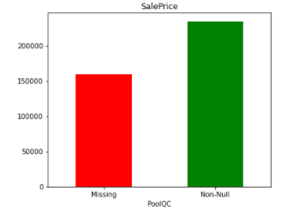
DATA EXPLORATION
Missing Data:
There are 27 features with missing values, out of which 5 features have more than 45% missing values
Handling Missing Data:
Further explored columns with more than 80% missing data, instead of directly dropping
They had a significant impact on the Sale Price
Assuming that when a certain feature is missing in a property, it was left blank during data collection, imputed zero to missing numeric features and ‘None’ to missing categorical features

Slide 6
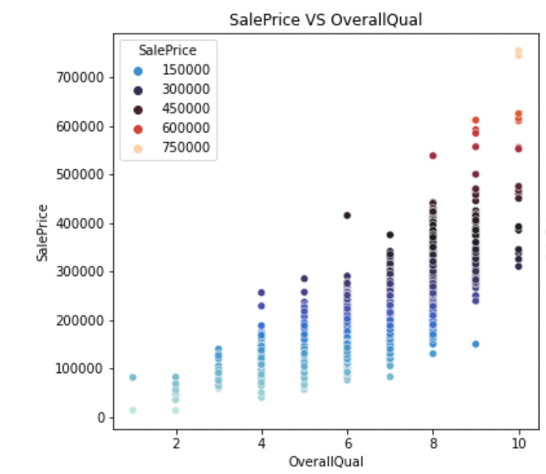
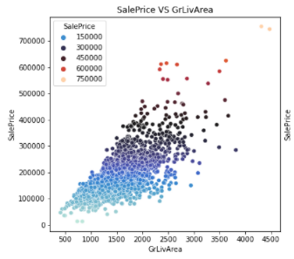
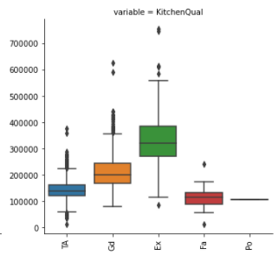
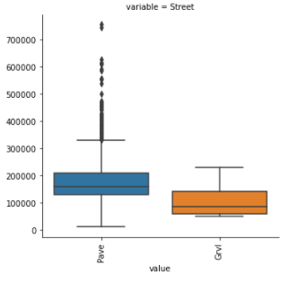
DATA EXPLORATION
Scatter Plots:
Plotted between all numeric variables vs. Sale Price
Noticed that many input variables are linearly dependent on Sale Price
Box Plots:
Plotted for all the categorical variables and identified that many variables have a notable relation with Sale Price
Identified the presence of outliers from the box plots

Slide 7
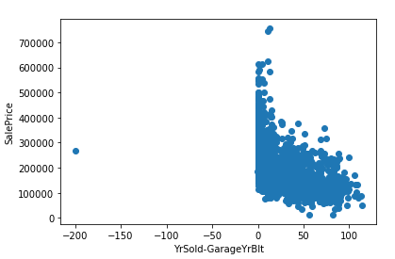
FEATURE ENGINEERING
Created new variables:
By combining a few existing numeric variables - Age of remodeling and Age of garage built
Ex: [Age of the house = Year Sold – Year Built]
Removing Outliers:
Identified variables having outliers by plotting scatter plots
Variables 'GrLivArea', 'GarageArea', 'TotalBsmtSF', 'LotArea’ had outliers
Built a function to identify points that fall outside the interquartile range and dropped those rows
4 outliers have been detected and removed

Slide 8
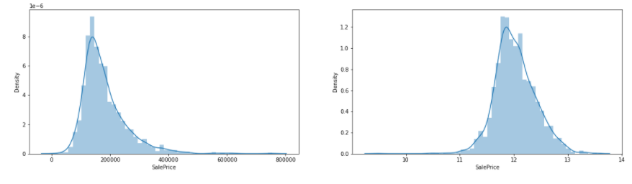
FEATURE ENGINEERING
Log Transformation:
The distribution of Sale Price is right-skewed
Hence, used log transformation to make this target variable follow a normal like distribution
Data Splitting :
We considered ‘YrSold’ variable as categorical as there are only 5 values. Hence, used train_test_split for training and test data sets
Used 25% data for test and 75% data for train. We used 10-fold cross validation method for model training
Used MinMaxScaler() for better interpretability and improving performance of the algorithm

Slide 9
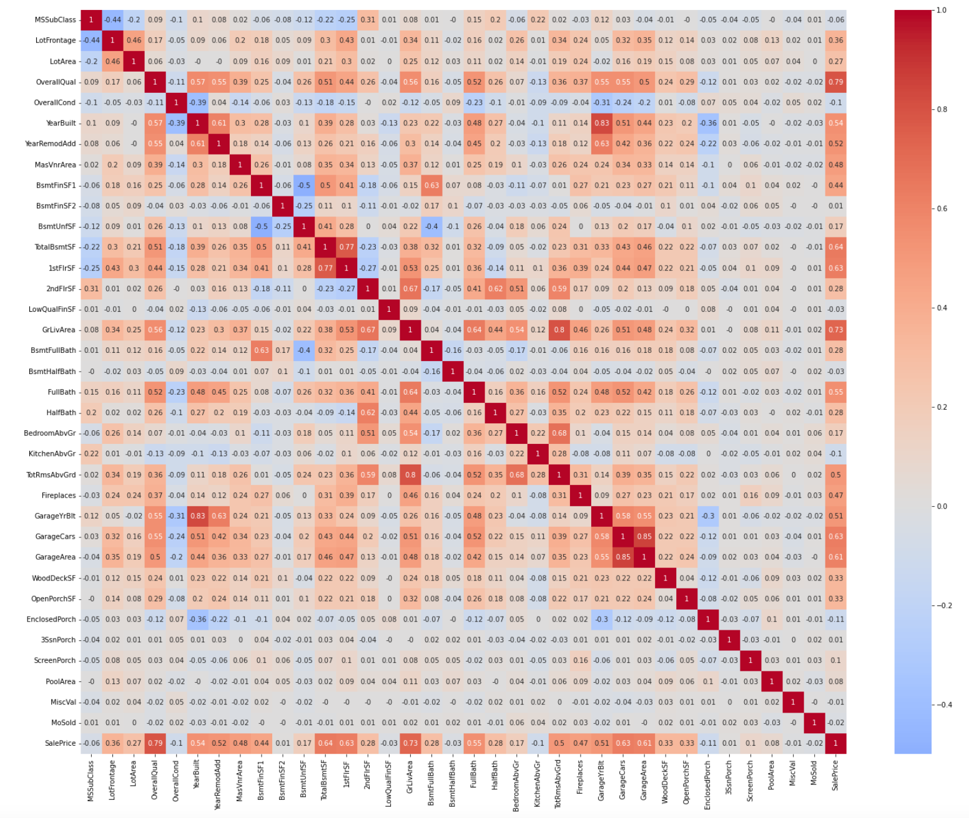
MULTICOLLINEARITY – Heat Map
Multicollinearity is one of the biggest problems with linear regression
Plotted a Heat map to inspect this
Few independent variables were correlated with a correlation as high as 0.85
Considered a standard correlation factor of 0.6 as the threshold to handle multicollinearity problems
Dropped all columns with correlation factor > 0.6 from the upper triangle of the correlation matrix

Slide 10
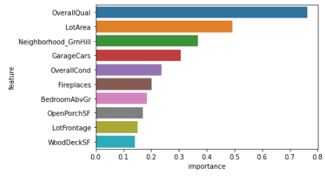
MODEL 1 – LINEAR REGRESSION
Properties of the model:
R-square value: 0.847
Mean Square Error (MSE): 0.0181
Reason for selecting this model:
Multiple columns in the data are linearly correlated with Sale Price
Easy to predict house price as we need only a set of coefficients
Top 10 features that increase Sale Price of a House

Slide 11
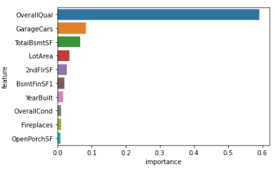
MODEL 2 – RANDOM FOREST (RFM)
Properties of the model:
R-square value: 0.857
Mean Square Error (MSE): 0.017
Reason for selecting this model:
Powerful Ensemble method that uses multiple Binary trees
Better accuracy in price predicting compared to Linear Regression Model
Top 10 important features for predicting Sale Price

Slide 12
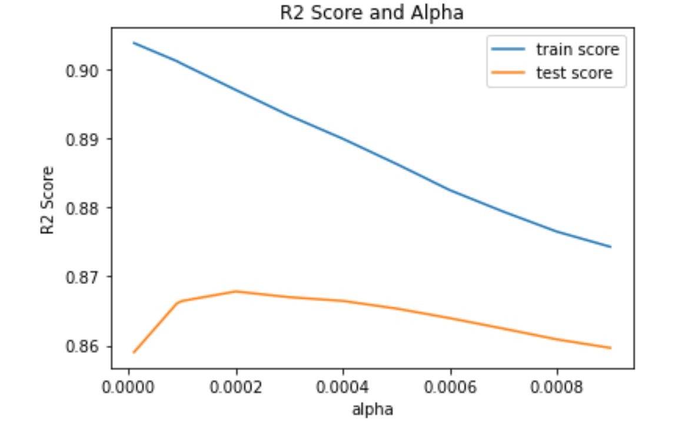
LINEAR REGRESSION
Applied Lasso and Ridge regularization methods
Used GridSearchCV to find optimal Alpha
Used VIF values for multicollinearity
Lasso is better than Ridge

Slide 13
RANDOM FOREST – BETTER MODEL
This ensemble model uses Bootstrap aggregating
I used GridsearchCV to find the optimal set of hyperparameters
Random Forest model is more powerful than the linear regression model
More scope for hyperparameter tuning

Slide 14
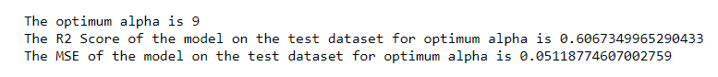
MULTIPLE FACTOR ANALYSIS
After Feature Engineering and One Hot Encoding we have more than 250 columns of data
We used MFA method to reduce these 250 columns into 11 columns
This improves run time and storage space required
Dimensionality reduction removes irrelevant features from the data

Slide 15
Thank You!

